Slide 1
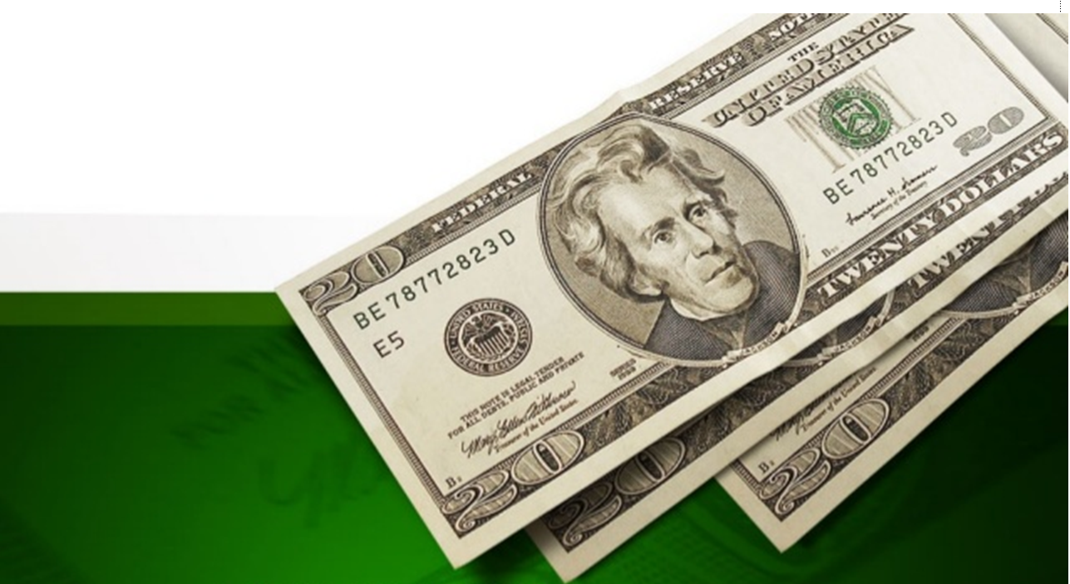
Unit Four
Money Talks

Slide 2

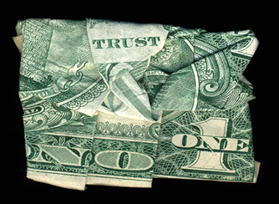
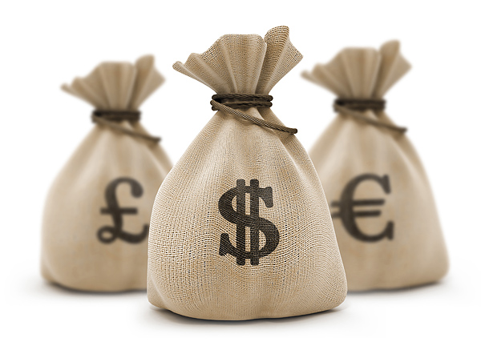
Warm-up
Share your favorite money quotes and use examples or personal experience to support your choice.
1. Money is the root of all evil.
2. Look after the pennies and the pounds will look after themselves.
3. Whoever said money can’t buy happiness didn’t know where to go shopping.

Slide 3
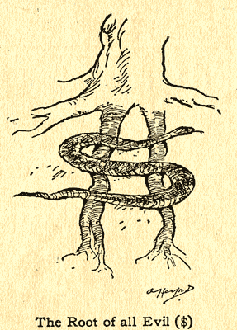
Warm-up
1. Money is the root of all evil.
Money is behind the crimes & wrong-doings in the world.
bank robberies
murders with a financial motive

Slide 4

Warm-up
1. Money is the root of all evil.
The love of money is the root of all evil.
The lack of money is the root of all evil.

Slide 5
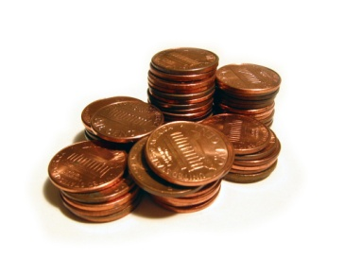
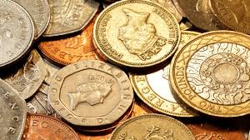
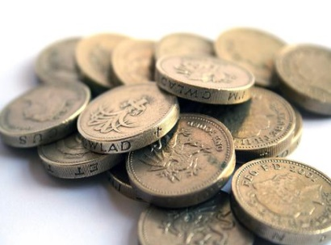
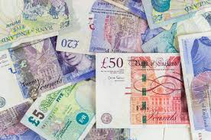
Warm-up
2. Look after the pennies and the pounds will look after themselves.
taking care of your spending & saving money
If you are careful about
small details
small amounts of money
the larger amounts of money will not need much attention (they will look after themselves)

Slide 6
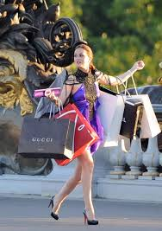
Warm-up
3. Whoever said money can’t buy happiness didn’t know where to go shopping.
If you know where to go shopping, you can, in fact, buy happiness.
Implication
You have to search for the right place.
but
Many people do not know where this is.

Slide 7

Warm-up
Listen to a recording & complete the summary.
A credit card allows you to 1) ________ something immediately and then pay for the bill for at a 2) _______ date. Once a credit card has been issued, you can make purchases within the prescribed credit 3) _________. A credit card with a limit of $100.00 enables you to pay for up to 4) ________ worth of items. Every month, you will receive credit card 5) ___________ that lists the charges you have made. You have to pay your bill in full by the 6) __________ date. Otherwise, you have to pay 7) __________ or a 8) _______ ________, which can be fairly high.
charge
later
limit
$100.00
statements
due
interest
finance charge

Slide 8

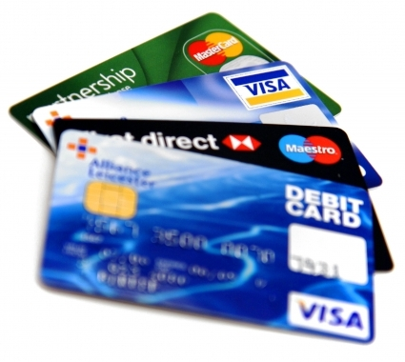
Views on credit cards
Warm-up
Watch a video clip and discuss the questions in groups.
click
What are the advantages of having a credit card?
2. What sort of customers do the credit card companies hate?
3. What are good customers for credit card companies?
4. How do credit card companies make profits?
5. What are the dangers of having a credit card?

Slide 9
Warm-up
What are the advantages of having a credit card?
You can pay for goods and services without using cash or a cheque which means that you only need to carry one card around with you.
You can spend more than you have.
2. Which sort of customers do the credit card companies hate?
people who pay off their bills on time
3. What are good customers for credit card companies?
people who don’t pay off their credit card debts
4. How do credit card companies make profits?
charging interest rates

Slide 10
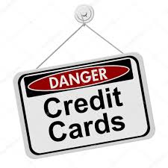
Warm-up
5. What are the dangers of having a credit card?
Improper use can damage credit rating
Higher risk for impulsive buying and overspending
Debt trap when used unwisely
Expensive way to borrow due to high interest rates
Less to spend in the future due to paying off purchases from the past
Possible hidden fees & surcharges
Privacy is an increasing concern
Identity theft easier

Slide 11
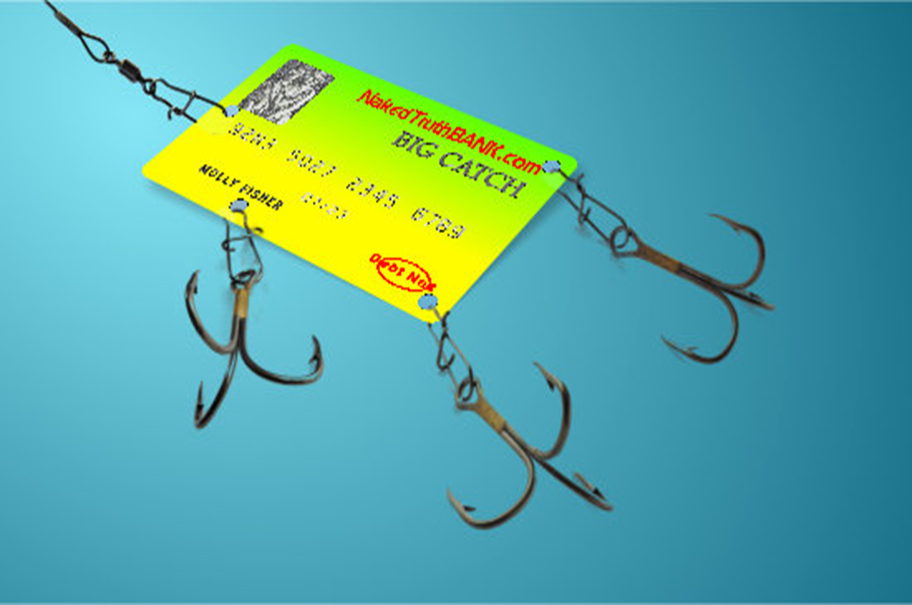
Text Organization
The Credit Card Trap

Slide 12
Text Organization
Story 1
Story 2
Story 3
Main idea:
Banks set traps which appeal to our vanity and greed and sometimes to our basic need for survival.
Solution:
cutting ourselves off from the bank

Slide 13
Text Comprehension
Answer the questions.
click
Why did the author desire to apply for a gold card?
Which sort of customers do credit card companies want?
How do credit card companies lure poor students into applying for a credit card?
What did Kelly have to pay when she went over the limit on her overdraft?
Why was Kelly recorded as a bad credit risk? How did it affect her life?

Slide 14
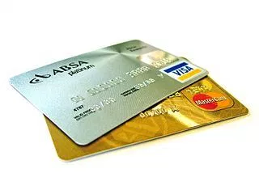
Text Comprehension
Answer the questions.
Why did the author desire to apply for a gold card?
It was a status symbol, which made her feel good with herself and desirable to others.
2. Which sort of customers do credit card companies want?
People who are likely to spend more money than they have.
3. How do credit card companies lure poor students into applying for a credit card?
unrealistic interest rates/low interests.

Slide 15

Text Comprehension
4. What did Kelly have to pay when she went over the limit on her overdraft?
She had to pay for the overdraft and high monthly interest on the overspend of the overdraft.
5. Why was Kelly recorded as a bad credit risk? How did it affect her life?
She was unable to pay bank charges, credit
card debts and interest, so she was recorded
as a bad credit risk.
It prevented her from getting a student loan,
therefore, she had to drop out of the university.

Slide 16
Text Comprehension
Look at the sentences from the passage and answer the questions.
I have a confession.
Has the writer done something seriously wrong?
2. How did she do this? How could this be? I knew I earned more than her, my car was newer, and my house was smarter. How did she get to appear more flash than me?
What effect does the series of questions have?
3. She has a student loan of £3,000, like most of her friends, and a small allowance from her poor mother (ha!) for transport, books and living expenses.
Ha! is an aside which indicates a laugh. What is the laugh for?
click
click
click

Slide 17
Text Comprehension
Look at the sentences from the passage and answer the questions.
4. She hugged me (never usually does that) and then said, “Mum, I need to talk to you.”
Why does the writer add the detail in brackets?
5. Her bank! I trusted them! They know even better than I do how broke she is.
What effect do the exclamation marks have?
6. I want you to lay out all of your credit cards in a line, take a large pair of scissors and cut them into small pieces.
Is this a realistic instruction? Why does the writer conclude with this image?
click
click
click

Slide 18

Text Comprehension
I have a confession.
Has the writer done something seriously wrong?
It makes an interesting and ironic beginning.
The writer is about to reveal a personal statement, which draws the reader into the passage.
The confession is actually about something small and quite trivial.
but
The writer uses the story to raise serious issues about credit cards and banks.

Slide 19

Text Comprehension
2. How did she do this? How could this be? I knew I earned more than her, my car was newer, and my house was smarter. How did she get to appear more flash than me?
What effect does the series of questions have?
share the writer’s feelings with us
rhetorical questions
emphasize how the writer was puzzled & annoyed by the high-status gold card of her friend.

Slide 20
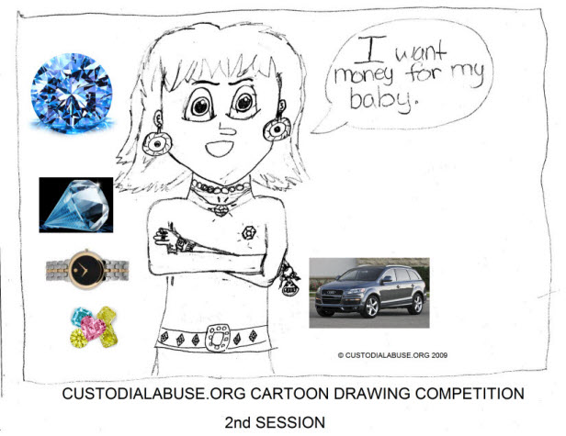
Text Comprehension
3. She has a student loan of £3,000, like most of her friends, and a small allowance from her poor mother (ha!) for transport, books and living expenses.
Ha! is an aside which indicates a laugh. What is the laugh for?
a mocking or ironic laugh
I’m poor but still have money to give my daughter an allowance.

Slide 21

Text Comprehension
4. She hugged me (never usually does that) and then said, “Mum, I need to talk to you.”
Why does the writer add the detail in brackets?
attention
how the daughter is being unusually nice to her mother
unusual hug
because
she wants to make a special request.
warn
The daughter is going to raise a serious matter.

Slide 22

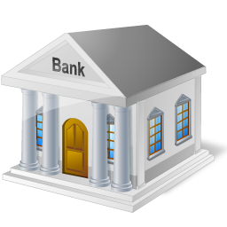
Text Comprehension
5. Her bank! I trusted them! They know even better than I do how broke she is.
What effect do the exclamation marks have?
the surprised feelings of the writer
emphasize
The bank seems to have betrayed the mother’s trust as well as exploiting the daughter’s financial situation.

Slide 23

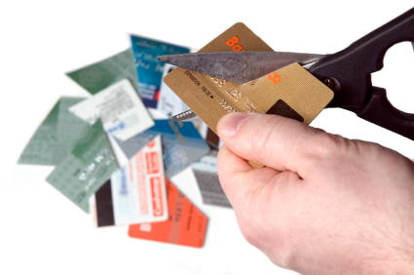
Text Comprehension
6. I want you to lay out all of your credit cards in a line, take a large pair of scissors and cut them into small pieces.
Is this a realistic instruction? Why does the writer conclude with this image?
it doesn’t seem realistic.
Destroying the credit card
a kind of revenge
a lesson for the banks

Slide 24

Text Comprehension
Techniques and stylistic features .
irony
humour
anecdotes
rhetorical questions
mixing formal and colloquial language
making asides (comments in brackets on her own account as it develops).

Slide 25
Summarising
Text Organization
Today, we are caught in the credit crunch because banks set traps which appeal to 1) ___________________________________________________________________.
The banks give a false sense of superiority to people with 2) _____________________________ in hard. They target people who are prone to 3) ________________, and 4) potentially ________________, tempted to 5) ____________ ______________, and liable to 6) ______________________________. They lure impoverished students with 7) ______________________.
our vanity and greed and sometimes to our basic need for survival
exclusive gold credit cards
impulse-buying
bad credit risks
spend more than they have
fall behind with repayments
unrealistic interest rates

Slide 26
Summarising
Text Organization
They charge people who go over the limit the exorbitant interest but omit to tell them the interest paid is not for the debt, but for 8) _________________________________. By attracting us with their 9)_________________ for loans of money, the banks earn money.
So how to get ourselves out of the traps? Lay out all of your credit cards in a line, take a large pair of scissors and cut them into small pieces. Then the banks have no 10) _______________________________________________.
the overspend of the overdraft
endless publicity
potential to tempt money away from you

Slide 27

Discussion
Work in pairs and discuss the questions.
Should schools teach children about money management?
Is it the responsibility of the family or the state to look after people’s finances? How could this be improved?
Would the world be able to function without banks? If so, would it be a better place to live in?

Slide 28
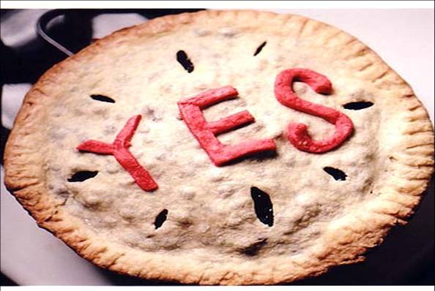
Discussion
1. Should schools teach children about money management?
an essential topic
financial calculations
setting goals, planning in steps & making decisions
bring together different aspects of money management to create a focus for children
ethics and morality in money management
relating money management to family life & household budgets

Slide 29
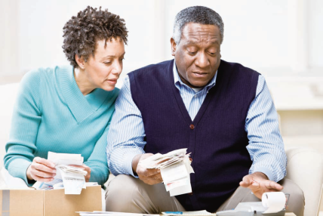
Discussion
2. Is it the responsibility of the family or the state to look after people’s finances? How could this be improved?
work to provide for themselves and their families if they are able
things have improved a lot
receive state assistance if they aren’t able to support themselves
the likes of maternity benefits & minimum wage policies

Slide 30
Discussion
3. Would the world be able to function without banks? If so, would it be a better place to live in?
indispensable
19th century
deposits, loans, credit transfer etc
crucial
20th century
state functions, national and international commerce, business, and personal and family money management
The present world can’t really function without them but it would be a happier place if banks gave priority to trust, security and public benefits.

Slide 31
Difficult sentences
My credit card was a fairly pathetic — whereas hers was a very exclusive gold one. (Para. 1)
They target people who are prone to impulse-buying — liable to fall behind with repayments. (Para. 7)
After I’d hauled her back into the house... and so on. (Para. 12)
4. Naturally, there was a lengthy correspondence … and her debts began to rise more than £200 above the agreed limit on her overdraft of £1,500. (Para. 14)
5. And here we are today, caught in the credit crunch, — attracting us with endless publicity for loans of money which even they didn’t have! (Para. 24)

Slide 32
Difficult sentences
My credit card was a fairly pathetic, status-free dark blue, whereas hers was a very exclusive gold one. (Para. 1)
Paraphrase the sentence.
click
My credit card looked quite shabby. It was dark blue and ordinary, and it did not have any particular status. Hers was gold and was limited to a particular group.
click
How did the writer feel?
She felt inferior and wanted a gold credit card too.
click
3. Translate the sentence.
我的信用卡太寒酸了，是不显示身份地位的深蓝色卡，而她的信用卡则是高级的金卡。

Slide 33
Difficult sentences
They target people who are prone to impulse-buying, and potentially bad credit risks, tempted to spend more than they have, and liable to fall behind with repayments. (Para 7)
1. Paraphrase the sentence.
click
The credit card companies or banks direct their advertising and sales promotions at people who are very likely to buy things on impulse (without planning), who may not be able to pay their debts, who spend more money than they have, and who will not make repayments on time.
Translate the sentence.
click
他们的目标客户是那些随时有购物刷卡的冲动、有潜在信用风险、经不住诱惑超支消费并且经常延期还款的人。

Slide 34
Difficult sentences
After I’d hauled her back into the house, it transpired that her bank had written to her offering a credit card at a low interest rate for a trial three-month period, subject to suitability ... and so on. (Para 12)
1. What does subject to mean?
click
Here subject to indicates a likelihood that sth. will happen.
click
2. Translate the sentence.
我费了好大劲儿才把她从外面拽了回来。原来她的银行来信告诉她说：她可以申请一张试用期为三个月的、能够低息贷款的信用卡，只要满足要求······如此云云。

Slide 35
Difficult sentences
Naturally, there was a lengthy correspondence … and her debts began to rise more than £200 above the agreed limit on her overdraft of £1,500. (Para 14)
1. How did she solve the problem of not accessing her funds?
click
Communicating with the bank by the exchange of letters for a long time.
click
2. What does she went into the red mean?
It means she has spent more money than she has on her bank account.
click
3. Translate the sentence.
通过书信同银行交涉的时间相当长，而未能及时支付帐户资金使得她欠了银行的债，欠款额超过了透支额度（1,500 英镑）200 多英镑。

Slide 36
Difficult sentences
And here we are today, caught in the credit crunch, with world economies in free fall, all because the wicked bankers set us traps which we fell into, attracting us with endless publicity for loans of money which even they didn’t have! (Para 24)
1. Analyze the structure of the sentence.
click
There is a main clause we are today, caught in the credit crunch, an adverbial clause introduced by because.
2. Translate the sentence.
click
这就是我们现在的处境。随着世界经济一落千丈，我们都处在信贷危机之中。所有这一切都是因为邪恶的银行家通过大量广告推销他们压根就不存在的贷款来吸引我们，给我们设圈套！

Slide 37
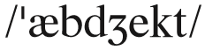
Words & Phrases
Words & Expression
abject a. (fml) complete: used for emphasizing how bad, unpleasant, or severe a situation or condition is 完全的（用于强调非常糟糕、不愉快或严峻的形势或条件）
e.g.
Even the offer of US dollars in the midst of abject poverty produced only shrugs, because there was simply no food to buy.
在赤贫的环境中，就连美元也只能换来束手无策的表情，原因很简单，那里买不到任何食物。
2. This policy has turned out to be an abject failure.
这一政策最后以惨败而告终。
3. His letter plunged her into abject misery.
他的信使她陷入极度痛苦之中。

Slide 38
exclusive
Words & Expression
adj. very expensive, and therefore available only to people who have a lot of money
Translate the phrases.
exclusive restaurant
exclusive rights
exclusive interview
exclusive attention
exclusive use
高档餐厅
专有权
专访
独家关注
专用

Slide 39

Language Points
Words & Expression
How did she get to appear more flash than me?
flash: a. if sb. is ﬂash, they own expensive things in order to show how much money they have 奢华的；炫耀的；显摆的
Flash usually shows that you do not like people like this. It’s often derogatory; but remember that the passage also has humorous elements, so it’s not really used in a derogatory sense here. It’s more that the writer is using a rather informal term to provide humour.
See also: flashy
翻译：
她怎么看起来显得比我光鲜呢？

Slide 40
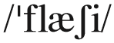
Words & Phrases
Words & Expression
flashy a. fashionable and noticeable, but in a somewhat vulgar way. 华而不实的; 华丽的
e.g.
1. Because of the growing numbers of rich individuals, large houses and flashy cars are no longer a sufficient demonstration of wealth.
由于有钱人越来越多，豪宅名车已经不足以展示财富了。
2. Maybe your friend is really impressed when he sees someone wearing a flashy watch – but you think that person shouldn’t splash money around.
See also: flash

Slide 41
distinctive
Words & Expression
adj. easy to recognize because of being different from other people or things of the same type
Complete the sentences with the words in the column.
distinct distinctly distinction distinctive
distinction
We should make a ___________ between right and wrong.
A ___________ outfit intended to identify those who wear it as members of a specific group.
They were classified into two _____________ groups.
The choir was (singing) ___________ out of tune in places.
distinctive
distinct
distinctly

Slide 42
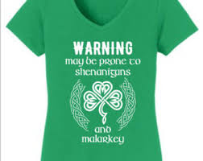
prone
Words & Expression
adj. likely to do something or be affected by something, especially something bad
Answer the questions.
When are people more prone to making mistakes?
People are more prone to making mistakes when they are tired.
2. Which region is prone to earthquakes?
The costal region is prone to earthquakes.
3. Which one is more prone to gaining weight,
a man or a woman?
A woman.

Slide 43
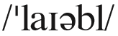
Words & Phrases
Words & Expression
liable a. (never before noun) (~ to do sth.) likely to do sth. bad or unpleasant 易出问题的；易做坏事的
e.g.
1. Your statement is liable to cause misunderstanding.
你的话容易引起误会。
2. In a depression banks are liable to fail.
在经济萧条期间，银行很可能倒闭。
Choose the proper answer to fill in the blank.
It is said that the math teacher seems ______ towards bright students. (CET4-2000-06)
A. partial B. beneficial C. preferable D. liable
A

Slide 44
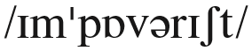
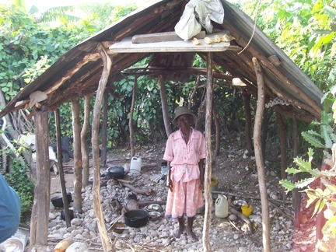
Words & Phrases
Words & Expressions
impoverished a. very poor 贫困的；赤贫的
e.g.
1. The impoverished family subsisted
on charity.
那个贫穷的家庭靠救济金过日子。
2. Money and food were sent to
the impoverished drought victims.
人们给干旱中贫困的灾民送去了救济金和粮食。
Word family: impoverish vt.
Synonym: destitute; penniless; broke; skint

Slide 45
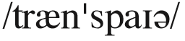

Words & Phrases
Words & Expressions
transpire vi. (fml) to happen 发生
e.g.
1. Nothing is known as yet about what transpired at the meeting.
会议上发生了什么还不得而知。
2. We do not know what may transpire when we have a new boss.
新老板来后，我们不知会有什么发生。
See also: it transpired (that)

Slide 46

Correspondence n.
Words & Expressions
Discuss the meaning of correspondence.
We have exchanged correspondence
about the best way to pay back the debt.
a number of letters
2. She kept up a thirty-year correspondence with Mary.
the act of writing and receiving letters
3. There is a definite correspondence between infant mortality and poverty.
a close similarity or connection between two things

Slide 47
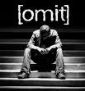
omit
Words & Expression
v. fail to include someone or something, either deliberately or because you forget
Make sentences with the words.
1. Important details; omit; article
Important details had been omitted from the article.
2. His new girlfriend; omit; tell him; married.
His new girlfriend omitted to tell him she was married.
3. Serious omission; mention; cost
One serious omission is any mention of the cost.
Word family: omission n.
See also: omit to do sth.

Slide 48
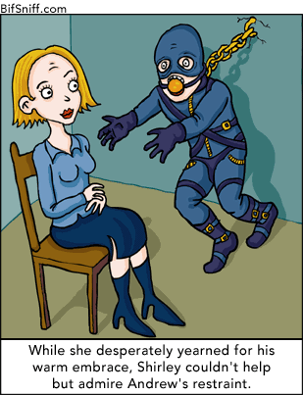
 restraint
Words & Expression
n. the limit or control of the expression of strong emotion or opinion
Complete the sentences with appropriate prepositions.
We need to exercise restraint ________ spending.
Please restrain yourself ________ coughing during the performance.
He left of his own will and not __________ restraint.
on
from
under

Slide 49
economical
Words & Expression
adj. not spending or costing much money
Complete the sentences with the words in the column.
economy economic economics economical
He always was _____________ when it came to buying presents.
Marry studied _____________ at Oxford University.
_______________ growth is slowing down,
The last five years have seen a consistent improvement in the country’s ________________.
economical
economics
Economic
economy

Slide 50
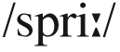
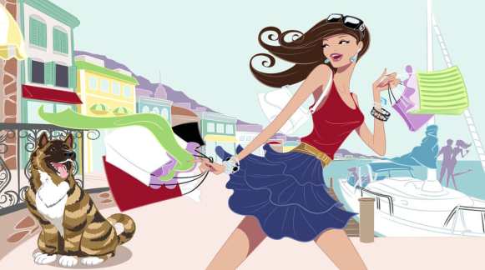
Words & Phrases
Words & Expression
spree n. [C] a short period that you spend doing only one activity, esp. sth. enjoyable such as spending money or drinking alcohol（尤指）狂欢作乐
e.g.
1. She recently went on a huge shopping spree with her Christmas bonus.
最近她拿着圣诞发的红包疯狂购物。
2. Our team went on a scoring spree and won by ten goals to zero.
我们的球队继续疯狂进球，以十比零取胜。
See also: go on spending sprees

Slide 51
 publicity
Words & Expression
n. information that makes people notice a person, product etc
Rewrite the sentences with the words in the brackets.
The public show a lot of interest in the singer star’s marriage. (publicity)
The singer star’s marriage ___________________________.
2. The concert attracted a lot of attention in the newspaper. (publicity)
The newspaper _______________________________________.
3. The author appeared on television to make her latest book known to the public. (publicize)
The author appeared on television to _____________________________.
received wide publicity
gave much publicity to the concert
publicize her latest book

Slide 52
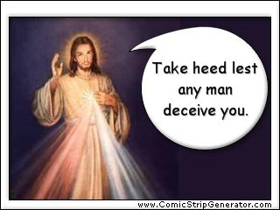
 deceive
Words & Expression
v. to fail to do something that would have been helpful or honest
Translate the sentences.
他骗我在文件上签了字。
He deceived me into signing the papers.
你如果还相信她爱你，你就是在欺骗自己。
You are deceiving yourself if you still believe that she loves you.
3. Unless my eyes deceive me, that’s your brother over there.
除非我看花了眼，那不是你兄弟吗？

Slide 53
in full
Words & Expressions
completely, including the whole of sth.
1. The tuition fee must be paid in full before next month.
学费必须在下个月之前全额支付。
2. The message from the markets was clear: investors don’t expect Greece and Ireland to pay their debts in full.
3. If you must take credit card debt please ensure that you pay it in full within the stipulated time to avoid debt accumulation and other penalties such as late payment.
市场发出的信号是十分清楚的：投资人并不期望希腊和爱尔兰能够全额偿还债务。
如果你必须承担信用卡债务，那么请确保在规定的时间内全部还清，避免债务的累积和如逾期付款之类的处罚。

Slide 54
It transpired that
Words & Expressions
people discover that it is the case. (人们) 发现
Complete the sentences.
1. It transpires that the reason for the couple’s depression is __________________________________ _________________.
2. It transpired that the woman he quarreled in the morning ___________________________.
they believe they are unable to conceive
was the new manager

Slide 55
subject to
Words & Expressions
being under domination, control, or influence
They denied a report that Egypt had agreed to a summit, subject to certain conditions.
Like any successful executive, though, you seek out the best help you can get, subject to your time and money constraints.
他们否认了宣称埃及已同意在特定条件下参加峰会的报道。
像每一个成功的执行官一样，虽然你能找到你能得到的最佳帮助，但是还是要受到时间和金钱的约束。

Slide 56
Words & Phrases
Words & Expressions
sort out: to solve a problem or deal with a difficult situation successfully（成功地）解决，处理
e.g.
1. I need a professional to sort out my finances.
我需要一位专业人士为我处理财务。
2. Roy is the expert so they gave him a free hand to sort out the problem.
罗伊是专家，因此他们让他可以自主地处理那个问题。

Slide 57
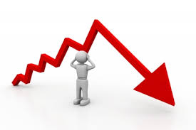

into/out of the red
Words & Expressions
If you go into the red, have you
done something embarrassing, or
spent more money than you have on your bank account?
Answer the questions.
1. Why does in the red mean in debt?
In bank accounts, an amount that was owed used to be written in red figures, not black.
2. What’s the opposite of in the red?
in the black
3. If someone sees red, how does he feel?
He feels angry.

Slide 58
Words & Phrases
Words & Expressions
omit to do sth.: (fml) to fail to do sth. that would have been helpful or honest 未做（本应有帮助或诚实的）某事
e.g.
I’m sorry I omitted to mention when he was leaving.
对不起，我忘了说他离开的时间了。
The problem was, he had omitted to divorce his first wife.
问题是，他没有同他的第一个妻子离婚。
He omitted to tell the managing director that he lost the document.
他没有告诉总经理他弄丢了那些文件。

Slide 59
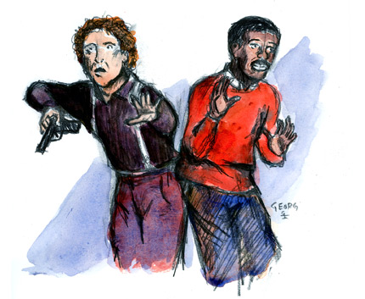
go from bad to worse
Words & Expressions
become even worse
Translate the sentence.
情形每况愈下：她丢了工作，接著又病了。
Things went from bad to worse: she lost her job and then became ill.
Figure out another word for go from bad to worse.
worsen/deteriorate/degenerate
Figure out the opposite of go from bad to worse.
get better and better

Slide 60
Language Points
Words & Expressions
She didn’t go on spending sprees buying new shoes …
go on spending sprees: to spend a lot of money doing sth. Variations of the expression include a buying / shopping / drinking etc spree ( 乱买 / 疯狂采购一番 / 狂饮).
e.g. Mom went on a shopping spree and bought three new outfits.
妈妈出去大采购了一番，买了3套新衣服。
翻译：
她并没有疯狂刷卡买鞋子……

Slide 61

lay out
Words & Expressions
(1) to spread something out or arrange things so you can see them easily
(2) to arrange something according to a detailed plan
Translate the sentences.
1. 这本小册子编排巧妙，插图精美。
This brochure is beautifully laid out and illustrated.
2. 我把我的衣服全都准备好然后摊开放在床上。
I have all my dress all ready and laid out on the bed.

Slide 62
Useful Expressions
1.对······感到很满意
1. feel contented by
2.莫大的羞耻
2. abject shame
3.付清信用卡欠款
3. pay off credit debts
4.信用等级高
4. have a good credit rating
5.从打击中回过神来
5. recover from the shock
6.随时有购物刷卡的冲动
6. be prone to impulse-buying
7.超支消费
7. spend more than they have
8.超低利率
8. unrealistic interest rates
9.担当保证人
9. act as a guarantee
10.事情是这样的······
10. It transpired that…

Slide 63
Useful Expressions
11.访问帐户资金
11. access funds in sb.’s current account
12.欠债
12. go into the red
13.超支
13. go over the limit
14.事情越来越糟
14. Things go from bad to worse.
15.消费节制有度
15. have great restraint with one’s spending
16.生活节俭
16. be economical about one’s lifestyle
17.继续完成大学学业
17. have another go at university
18.设下陷阱
18. set traps
19.把······排成一排
19. lay out sth. in a line
20.从······身上骗钱
20. tempt money away from

Slide 64
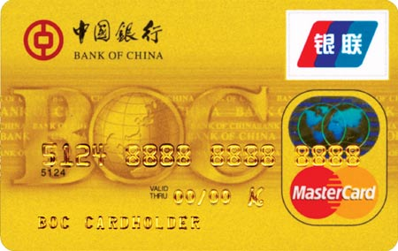
Reading Credit Cards
Read the front and reverse side of a credit card and match numbers with their names.

Slide 65
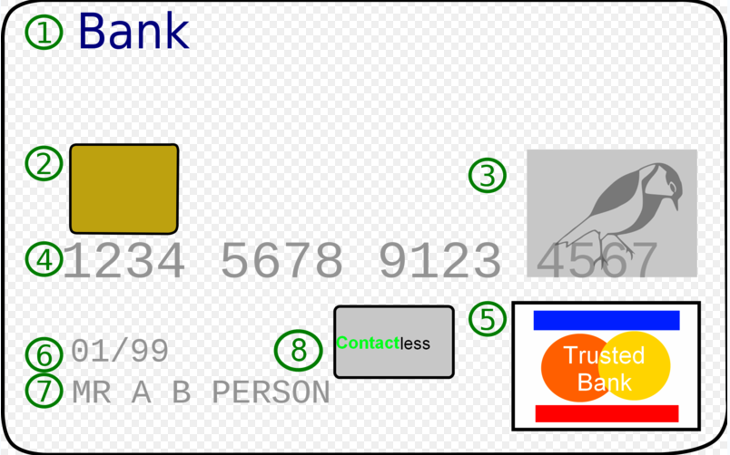
Reading credit cards
Reading Credit Cards
f
e
h
d
g
c
a
b
a. Card brand logo b. Card Holder Name c. Contactless chip d. Credit card number
e. EMV chip on “smart cards” f. Issuing bank logo
g. Expiration Date h. Hologram (Visa‘s logo )
click
In 1984, most Visa cards around the world began to feature a hologram of a dove on its face, generally under the last four digits of the Visa number. This was implemented as a security feature - true holograms would appear 3-dimensional and the image would change as the card was turned. On most Visa cards, holding the face of the card under an ultraviolet light will reveal the dove picture, as an additional security test. (On newer Visa cards, the UV dove is replaced by a small V over the Visa logo.)

Slide 66
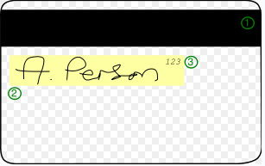
Reading Credit Cards
b
a
c
Card Security Code
Magnetic Stripe
Signature Strip

Slide 67
Credit Card Terms
1.发卡银行
1. issuing bank
2.年费
2. annual fee
3.信用额度
3. credit line/limit
4.利率
4. interest rate
5.月结单
5. monthly statement
6.信用卡余额代偿
6. balance transfer
7.开卡
7. activate a card
8.积点回馈
8. reward program
9.红利积点
9. point
10.预借现金
10. cash advance
11.认同卡
11. affinity card

Slide 68
Credit card terms
Credit Card Terms
12.现金卡
12. cash advance card
13.白金卡
13. platinum card
14.学生卡
14. student card
15.金卡
15. preferred card/gold card
16.储值卡
16. value card
17.普卡
17. classic card
18.联名卡
18. co-branded card
19.附属卡
19. supplementary card
20.借记卡
20. debit card
21.签帐卡
21. charge card
22.商务卡
21. corporate card

